Slide 1




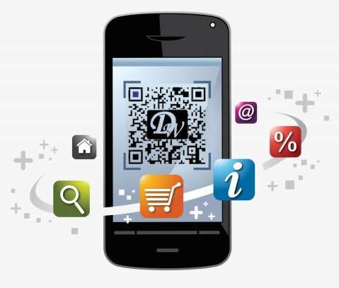
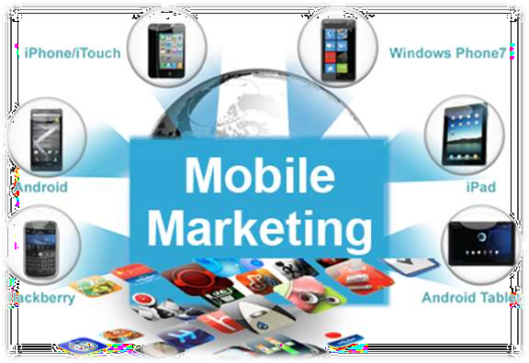
MOBILE MARKETING

Slide 2
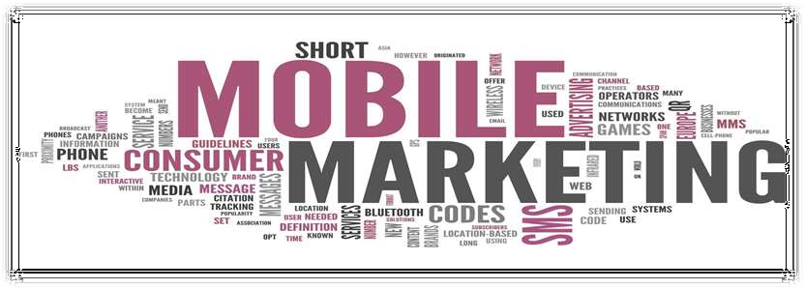
What is Mobile marketing?
Mobile marketing provide customers with time and location sensitive, personalized information that promotes goods, services and ideas.
In Brief, it is just the advertisements on your
smartphone.

Slide 3
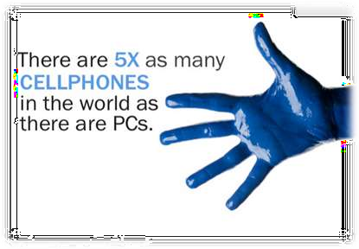
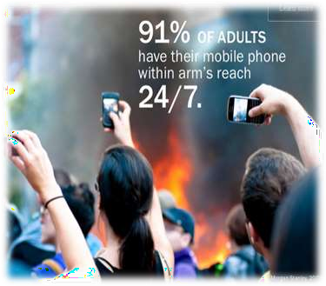
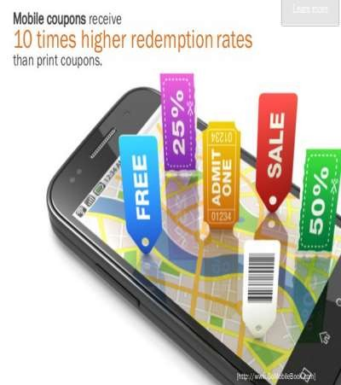
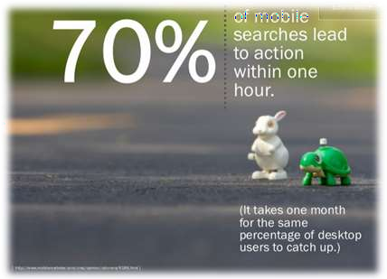
Why Mobile Marketing
Most of the transactions happen through mobiles
Which gives personalization to the customers.

Slide 4
Types of Mobile Marketing
SMS Marketing
Push Notifications
App based Marketing
In-Game mobile marketing
Mobile web marketing
QR codes

Slide 5
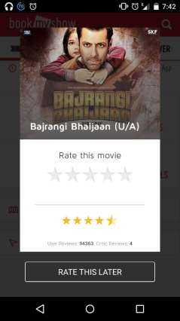
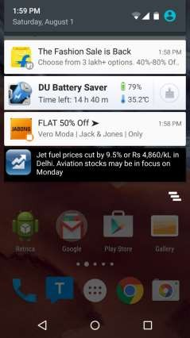
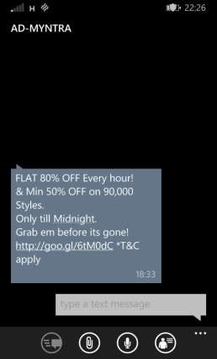

Examples
App Based
Push Notifications
SMS Marketing
In Game Marketing

Slide 6
Features
Omnipresence
Reach
Delivery
Distribution
Affordability
Targeted

Slide 7
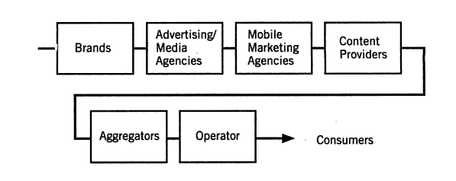
VALUE CHAIN MODEL

Slide 8
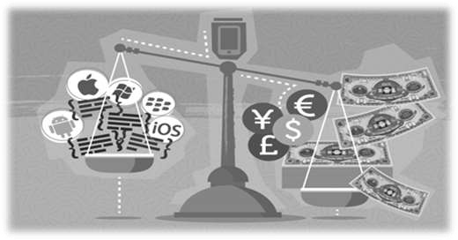
REVENUE MODEL
Pay per use
Sponsored services
Revenue Sharing

Slide 9


PRICING MODEL
Flat fee pricing
Value added pricing
Cost per thousand impression (CPM)
Cost per click (CPC)
Paid
Free
Freemium
Paidmium

Slide 10

ADVANTAGES
Instantaneous
Efficient
Convenient
Sharing
Consumer Relationship Management
Real Time Tracking
Customisable Mass Communication
Multimedia
Payment
Direct, Personalised Marketing

Slide 11

DISADVANTAGES
Platforms too diverse
Privacy and Permission
Questionable Navigation
Education

